Slide 1
PowerPoint presentation
Unit 308: Career awareness in building services engineering
Goal setting

Slide 2
CV advice
Follow the guidelines below to make sure you have included all the important information an employer may need.
Your personal details: You should include your name, address and contact details.
Your personal profile: This is a mini advert for you and should summarise:
Employment history and work experience: If you have been working for a while, you could put your employment history first.
Education and training: Start with your most recent qualifications and work back to the ones you achieved at school.
Interests and achievements: You can include hobbies, interests and achievements that are relevant to the job.
Additional information: You can include this section if you need to add anything else that is relevant.
References: At least one referee should be work related. Or, if you haven't worked for a while, you could use another responsible person who has known you for some time.

Slide 3
Personal statement
On many application forms you have to complete a section at the end called additional information or personal statement.
After you have filled in the sections on personal details, education and employment, this large, empty box is your chance to really impress a future employer.

Slide 4
Portfolio
Career portfolios are used to plan, organise and document education, work samples and skills.
Career portfolios serve as proof of one's skills, abilities and potential in the future.
Career portfolios help with a job or acceptance into higher education institutes.
A career portfolio should be personal and contain critical information.
Items that should be included include (but are not limited to) personal information, evaluations, sample work, and awards and acknowledgments.
In some industries, employers or admission offices commonly request a career portfolio, so it is a good idea to have an updated one to hand.

Slide 5
Cover letter
The covering letter and CV is the total package – your golden opportunity to sell yourself to employers.
They are going to read your covering letter before your CV so it is important that it makes an impact.
Covering letters that create a good first impression are well constructed, don’t contain any spelling mistakes or bad grammar, and support what you are saying in your CV.
Now read the step-by-step guide to writing a better letter:
General points: the purpose of a covering letter
The start: grab the reader's attention
The middle: why you're the best person for the job
Signing off: pulling it all together and arranging what is happening next.

Slide 6
References
Do not list your references on your CV.
Include a separate page with a list of three references (or whatever number the company asks for) and their contact information.
Your list of references should include professional connections who can attest to your qualifications for the job.
Your references don't have to be people who work at your current job – in fact, you shouldn't use them if the company isn't aware you are job searching.

Slide 7
Business plans
A business plan is a formal statement of a set of business goals, the reasons they are believed attainable, and the plan for reaching those goals.
It may also contain background information about the organisation or team attempting to reach those goals.
Business plans may also target changes in perception and branding by the customer, client, taxpayer or larger community.
When the existing business is to assume a major change, or when planning a new venture, a three to five-year business plan is required, as investors will look for their annual return in that timeframe.

Slide 8
Goal setting
Once you have written down your career aspirations, the next step is to identify your goals.
Your goals are the stepping stones you will use to reach your desired destination.
Keep in mind that the quality of the goals you set will determine their effectiveness.
You need to set out a realistic and achievable career path with short, medium and long-term goals.

Slide 9
SMART
S = Specific
M = Measurable
A = Attainable
R = Relevant
T = Time-bound
Goals need to be explicit and detailed.
Your goals should have a specific outcome against which you can measure your progress.
Goals must allow you to stretch yourself, but still be reasonable.
Each goal must have meaning for you.
Goals must clearly define a beginning and end.

Slide 10
S.M.A.R.T.
Here is an example of a poorly defined goal and then that same goal translated using the S.M.A.R.T. technique:
Poorly defined goal: I will work to improve myself in business.
S.M.A.R.T. goal: I will identify one area of weakness, and during the next six months, complete one class and read at least two books to improve my expertise in that business topic

Slide 11
SWOT analysis
This is a structured planning method used to evaluate your personal Strengths, Weaknesses, Opportunities and Threats.
Identification of SWOTs is important, as they can inform later steps in planning to achieve the objective.
It helps you to be honest about yourself and your aspirations, allowing you to outline your characteristics and your suitability.
Countless businesses and individuals throughout the world use this technique. While over the years many variations have been created, SWOT continues to embody sound principles for the process of creating goals.

Slide 12
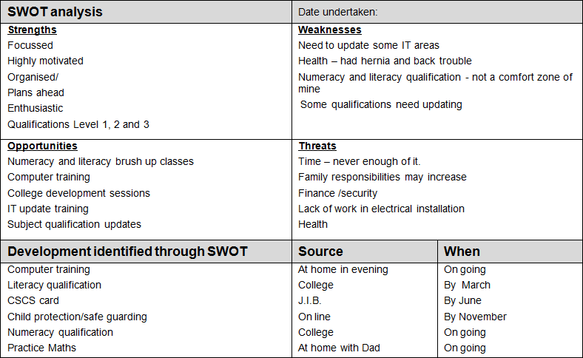
SWOT example

Slide 13
Any questions?

